Slide 1
Class (Implementation)

Slide 2
Fraction class
Let’s begin by creating a fraction class:
Before we begin, we need to know what we need for the fraction class?
We need at least you data, int num for numerator and int den for denominator
Now you need to create a header file (.h) that has the following;
For simplicity, we would always have the following 3 files fraction(version number).h
fraction(version number).cpp and user(version number).cpp
Let’s start with our very first class. In fraction00.h, you should have the following:

Slide 3
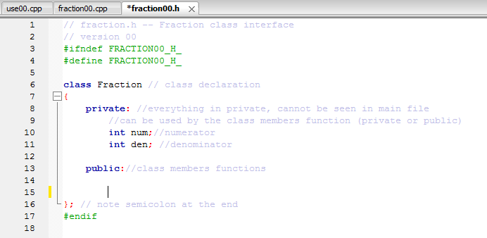

Slide 4
Class (explanation)
We have to start with class (user_defined type name), and ends with semicolon at the end
Anything (including data and class member functions) inside private means we don’t want the main body (user00.cpp) to be able to access it. We put num and den there since there is no need to change num and den explicitly inside main (will talk about it later)
All functions inside class (public or private) can access anything in private
Anything put in public means the main body (user00.cpp) can access it

Slide 5
What can a type Fraction do?
What do we want the fraction type to be able to do?
For starter, it would be nice to:
1)insert fraction number
2)show the size in decimal
3)show the fraction in fraction form
Since we probably want to be able to access those functions in the main body (user00.cpp), we would put them into the public section of the class in fraction00.h
Notice it is very similar to how we declare a function

Slide 6
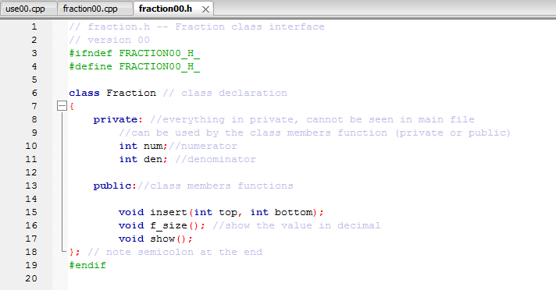

Slide 7
fration00.cpp
Now it’s time to implement the class member functions (public only in this example, but functions in private can also be implemented) in fraction.cpp!
The only difference is you have to put the phase Fraction:: (name of the class::) between return type and function time

Slide 8
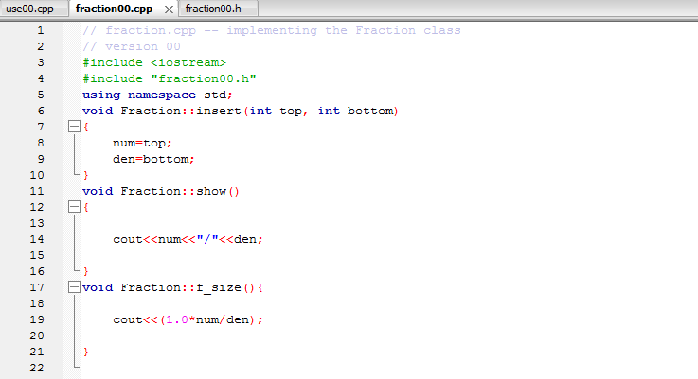

Slide 9
user00.cpp
Finally in user00.cpp
Things to notice:
You can create a variable under Fraction type (Ex Fration f), which creates an object f with num and den. Notice how similar it is to string class we have been using (Ex string s)!!!
We can access the method with f.insert(), f.f_size(), and f.show(), and notice that in the class method insert, we can access and change the num and den under f in Fraction type, without writing f.num and f.den explicitly in the main body

Slide 10
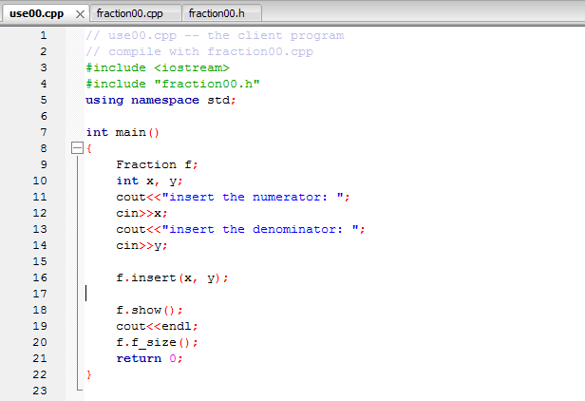

Slide 11
Output
When all files are put together as a project in code block, the output will be the following:

Slide 12
